Slide 1


Chromium’s Way to Wayland
October 11, 2017
Gyuyoung Kim
Igalia, GENIVI Alliance
This work is licensed under a Creative Commons Attribution-Share Alike 4.0 (CC BY-SA 4.0)
GENIVI is a registered trademark of the GENIVI Alliance in the USA and other countries.
Copyright © GENIVI Alliance 2017.

Slide 2
Content
Introduction of Igalia
Motivation
Background
History
Demo
Performance
Todo list
Plan to upstream
Rebase strategy
How to run Chromium wayland

Slide 3
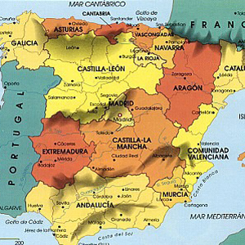

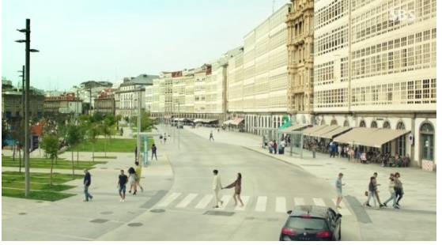
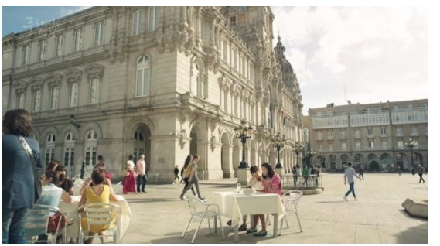
Introduction of Igalia
Worker-owned, employee-run open source consultancy company based on Galicia Coruna, Spain
<number> | October 11, 2017 | Copyright © GENIVI Alliance 2017

Slide 4
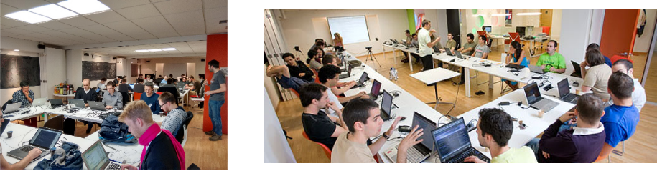
Introduction of Igalia (Cont.)
~60 employees around the world
Areas
Chromium/Blink, WebKit, and Servo
Compilers, JavaScript engines (v8, JSC)
Multimedia (GStreamer), Graphics (Mesa), Networking, Accessibility
<number> | October 11, 2017 | Copyright © GENIVI Alliance 2017

Slide 5
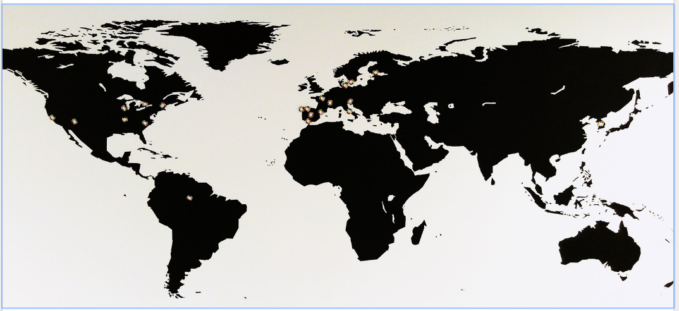

Introduction of Igalia (Cont.)
<number> | October 11, 2017 | Copyright © GENIVI Alliance 2017

Slide 6


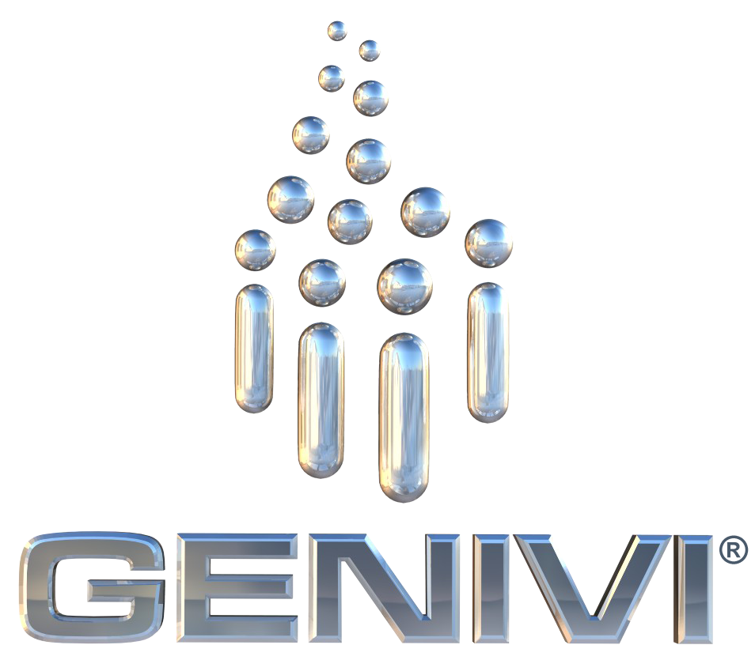

Motivation
Various platforms have been adopting Wayland as their windowing system
AGL, GENIVI, Raspberry Pi, Tizen, Bose, Volvo, Bosch, Jolla
Ubuntu 17.10 will ship Wayland by default
Fedora 25 is shipping Wayland by default
Major UI toolkits have built-in support, including Qt5, GTK+, Clutter, EFL
<number> | October 11, 2017 | Copyright © GENIVI Alliance 2017

Slide 7
Motivation (Cont.)
There have been a lot of demands that Chromium works on Wayland in the industries
Wayland has been getting more complete
<number> | October 11, 2017 | Copyright © GENIVI Alliance 2017

Slide 8
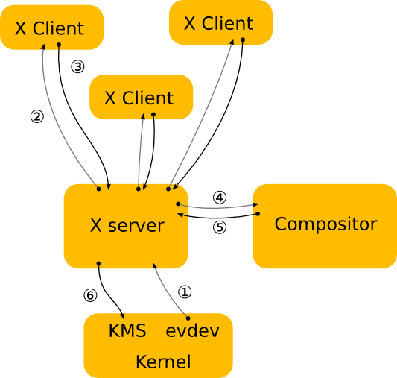
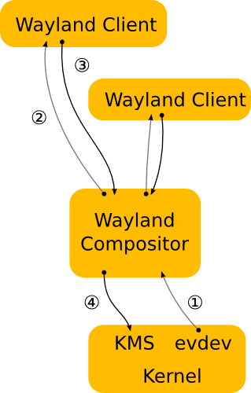
Background
vs.
X
Wayland
<number> | October 11, 2017 | Copyright © GENIVI Alliance 2017

Slide 9
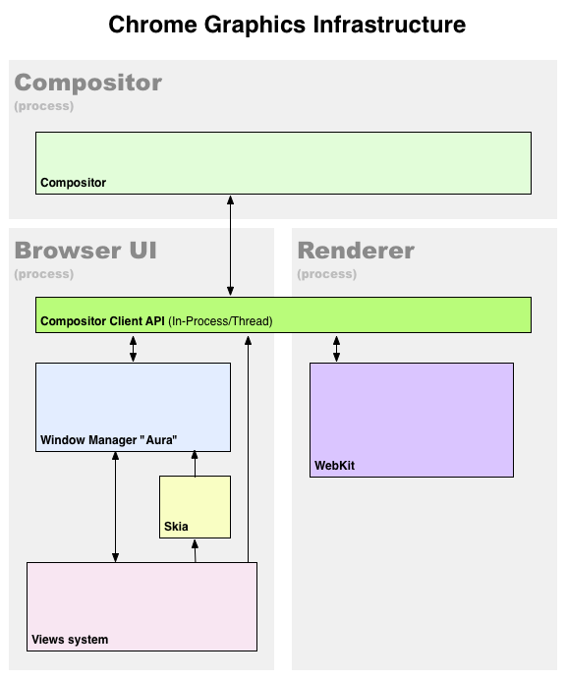
Background (Cont.)
Aura
To be brief, Aura is UI framework working on Chrome OS/Chromium
Aura provides window and event types, as well as interfaces to customize their behavior
<number> | October 11, 2017 | Copyright © GENIVI Alliance 2017

Slide 10
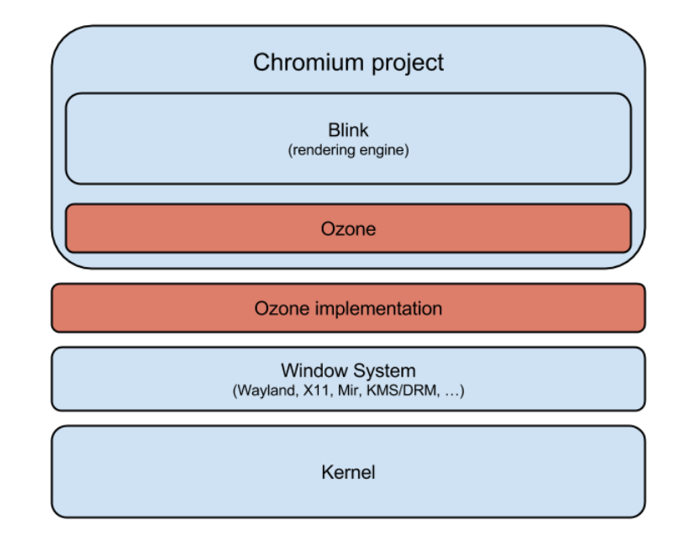
Background (Cont.)
Ozone
Abstraction layer for the construction of accelerated surfaces underlying the Aura toolkit
Process input devices assignment and event handling
<number> | October 11, 2017 | Copyright © GENIVI Alliance 2017

Slide 11
History
Ozone/Wayland project had been started by Intel since 2014 as their own Opensource project
The project entered maintenance mode in December 2015
However there was conflicts between Intel’s implementation and Google’s plan
Intel’s implementation vs. Chromium servicification
<number> | October 11, 2017 | Copyright © GENIVI Alliance 2017

Slide 12
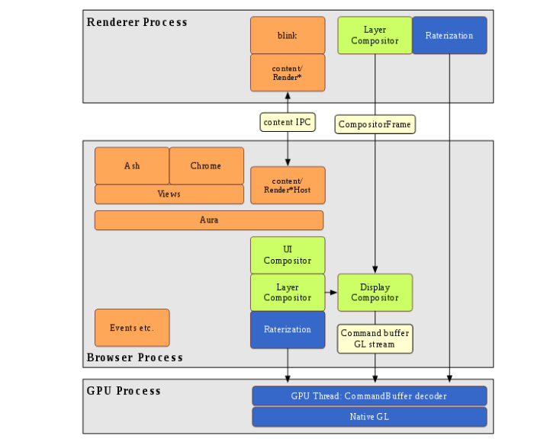
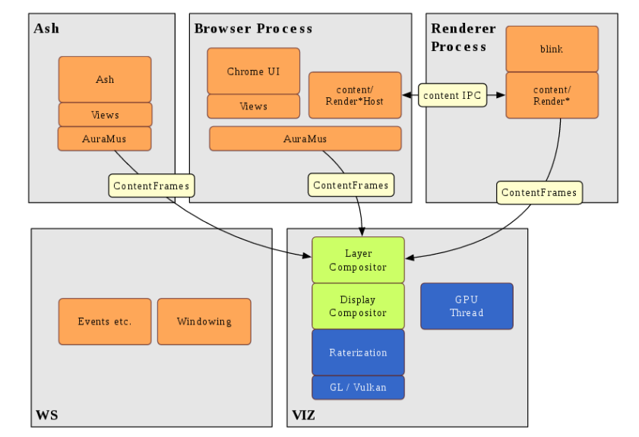
History (Cont.)
Eventually Intel stopped managing the Ozone/Wayland project
vs.
<number> | October 11, 2017 | Copyright © GENIVI Alliance 2017

Slide 13
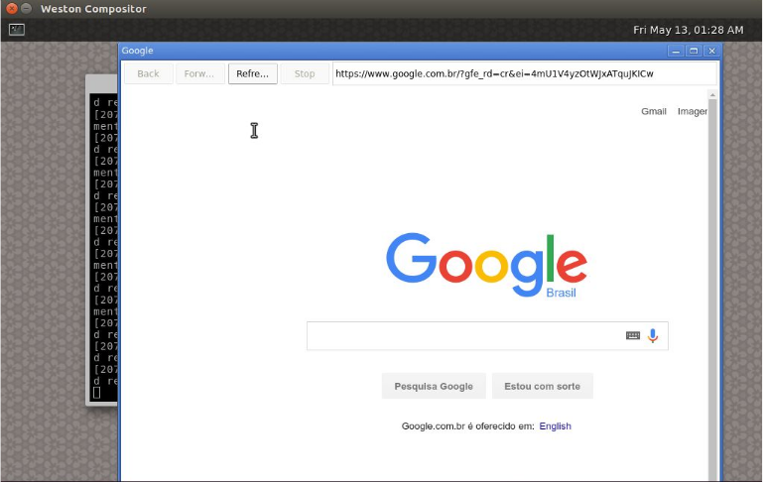
History (Cont.)
Igalia decided to start a new project with same end goal with Intel
- We fixed Ozone’s Wayland backend in Chromium mainline
- Didn’t start to upstream
Succeed to launch a content shell on Ozone/Wayland
<number> | October 11, 2017 | Copyright © GENIVI Alliance 2017

Slide 14
History (Cont.)
Igalia got in touch with Google/Chromium developers to understand their plans for Ozone/Wayland
Servicification
Mus/Ash
Igalia decided to follow up Chromium’s new architecture for Ozone/Wayland
<number> | October 11, 2017 | Copyright © GENIVI Alliance 2017

Slide 15
History (Cont.)
Start to work on Ozone/Wayland in earnest
Some problems at that time prior to Sep. 2016
Partial upstream from original Intel’s project
Insufficient documentation
Limited buildbot coverage
Improved by Igalia
Brought up of Ozone’s Wayland backend in Chromium trunk
Start experimenting with Ozone on Chromium desktop as well
Documentation
Setup buildbots
Design discussion with Robert Kroeger who is a lead UI framework at Google
<number> | October 11, 2017 | Copyright © GENIVI Alliance 2017

Slide 16
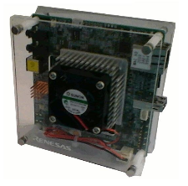
History (Cont.)
Finally Igalia exhibited initial Chromium Wayland on R-Car M3 board at CES 2016
<number> | October 11, 2017 | Copyright © GENIVI Alliance 2017

Slide 17
Demo of Chromium Wayland
<number> | October 11, 2017 | Copyright © GENIVI Alliance 2017

Slide 18
Performance
In some benchmarks, Ozone/Wayland is still a slightly lower performance compared to X11 version
System under test
HW: Dell XPS15
CPU: i7 cpu
RAM: 16GB
Source : Igalia Ozone wayland github on 27th Sep.
Bigger score is better
<number> | October 11, 2017 | Copyright © GENIVI Alliance 2017

Slide 19
Performance (Cont.)
After rebasing Ozone/Wayland version based on Chromium m62, rendering performance is much faster than before on R-Car m3 board
<number> | October 11, 2017 | Copyright © GENIVI Alliance 2017

Slide 20
Todo list
Fix drag and drop
Fix clipboard (it works as in internal window mode)
Multi screen support
Non-English keyboard layouts
Window closing
Mouse cursor
Ensure no feature losses or major performance penalties when compared to stock Chromium X11/Linux
Start to upstream the changes
<number> | October 11, 2017 | Copyright © GENIVI Alliance 2017

Slide 21
Plan to upstream
In WebEngine Hackfest on 1-3 October 2017, Antonio and Maksim have talked with Robert (Lead of Ozone at Google) about the upstream plan
Changes will be split in two big parts
We will start upstreaming one of them immediately
<number> | October 11, 2017 | Copyright © GENIVI Alliance 2017

Slide 22
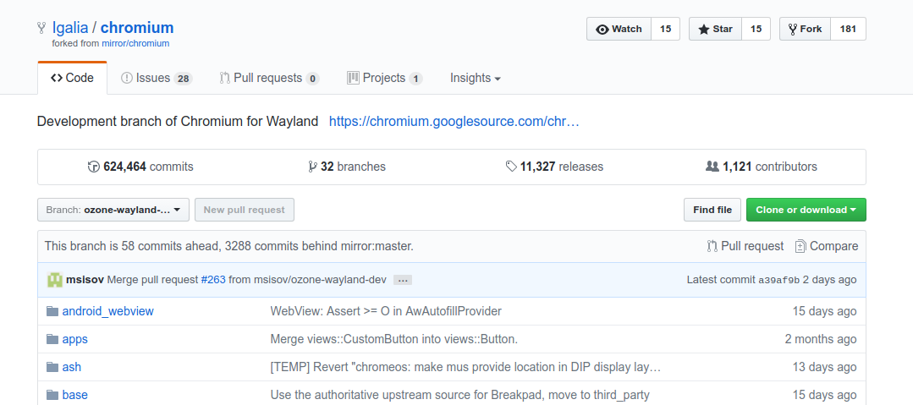
Rebase strategy
Ozone wayland has been developed at github
- https://github.com/Igalia/chromium
Rebased every week against Chromium ToT. Our goal is to be as close as possible to the latest Chromium code
Every week, a member of the Igalia Chromium team takes the rebase shift.
Commits that are complementary of each other, receive a "fixup!" prefix on the commit title, and keep the rest of original commit title unchanged.
<number> | October 11, 2017 | Copyright © GENIVI Alliance 2017

Slide 23
How to run Chromium Wayland
Steps
Setup Chromium build environment first
Install depot_tools and clone Chromium source code
Get Chromium Wayland branch from Igalia github
$ git remote add Igalia https://github.com/Igalia/chromium.git
$ git fetch Igalia
$ git checkout ozone-wayland-dev
Configuration
$ gn args out/Ozone --args="use_ozone=true enable_package_mash_services=true use_xkbcommon=true is_debug=false"
Build
$ ninja -C out/Ozone chrome
Run
$ .out/Ozone/chrome --mus --ozone-platform=wayland
<number> | October 11, 2017 | Copyright © GENIVI Alliance 2017

Slide 24
References
The Chromium project’s way to Wayland written by Antonio Gomes(tonikitoo)
Update on the open source browser space written by Jacobo Aragunde Pérez
Ozone-Wayland Architecture written by Intel
<number> | October 11, 2017 | Copyright © GENIVI Alliance 2017

Slide 25
Thank you!
gkim@igalia.com - Gyuyoung Kim
tonikitoo@igalia.com - Antonio Gomes
msisov@igalia.com - Maksim Sisov
mscho@igalia.com - Mi Sun Silvia Cho
This work is licensed under a Creative Commons Attribution-Share Alike 4.0 (CC BY-SA 4.0)
GENIVI is a registered trademark of the GENIVI Alliance in the USA and other countries.
Copyright © GENIVI Alliance 2017.
Notes:
<number>

